Slide 1
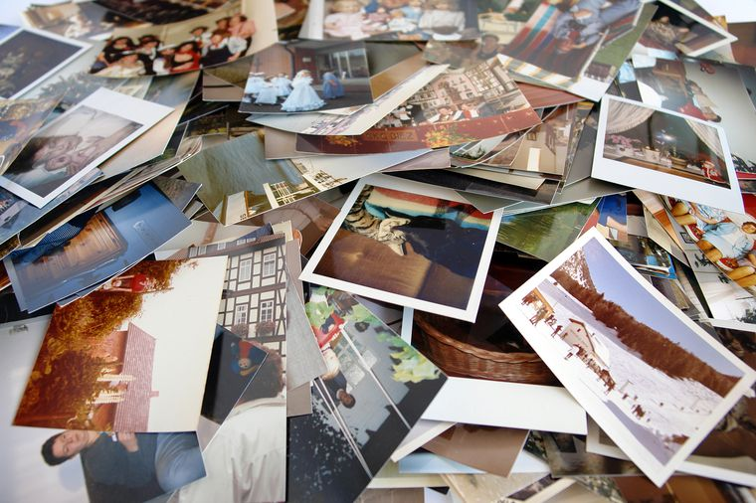
Digital Photo Organizer
Cigdem Tuncer
Istanbul Data Science Academy

Slide 2
INTRODUCTION
Our digital photo collections are particularly messy, since we take so many photos from so many different devices, without ever giving much thought to what images we will keep, where we will store them, and how we will ever retrieve them if we need them.
In this project, I would like to talk about the program I developed in order to separate the digital photos we have according to the date and location.

Slide 3
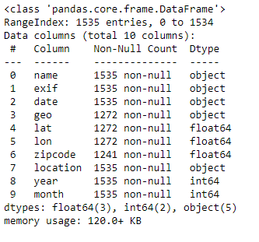
DATA
My personal digital photographs

Slide 4
METHODOLOGY
Image Processing
Feature Engineering
Python Graphical User Interface package (Tkinter)

Slide 5
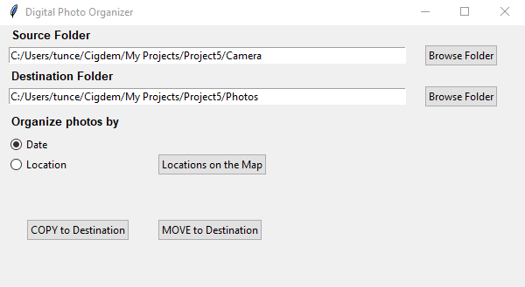
WINDOWS APPLICATION

Slide 6
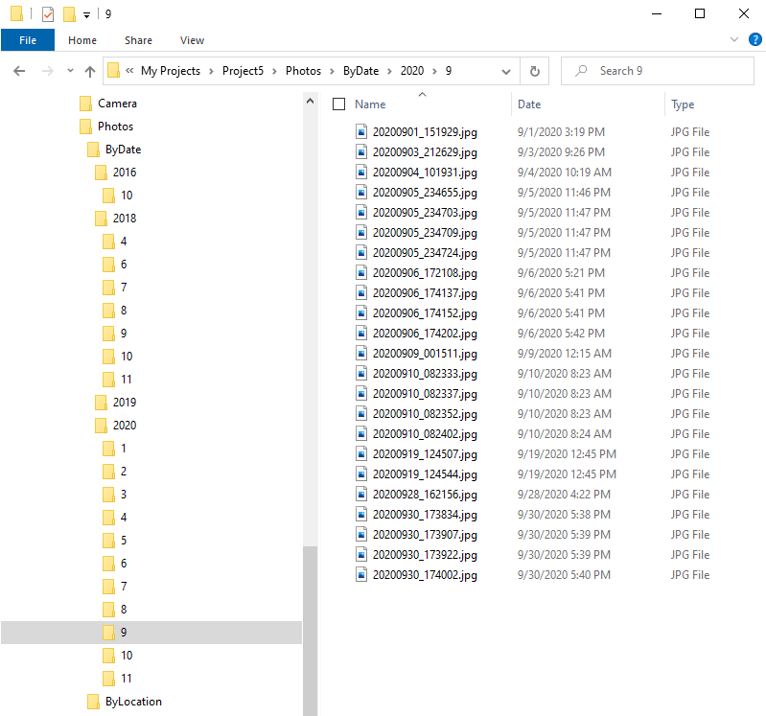
Copy/Move Files By Date

Slide 7
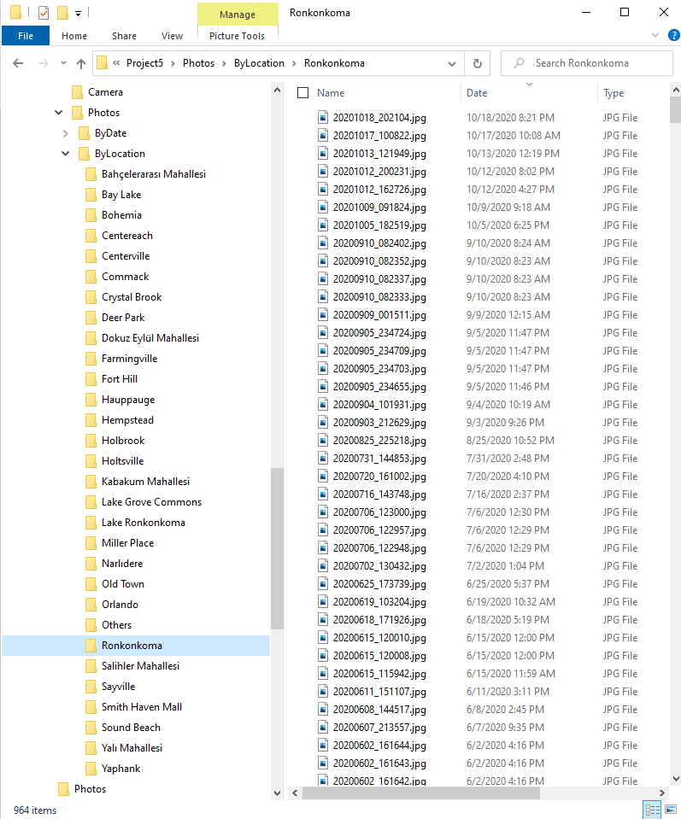
Copy/Move Files By Location

Slide 8
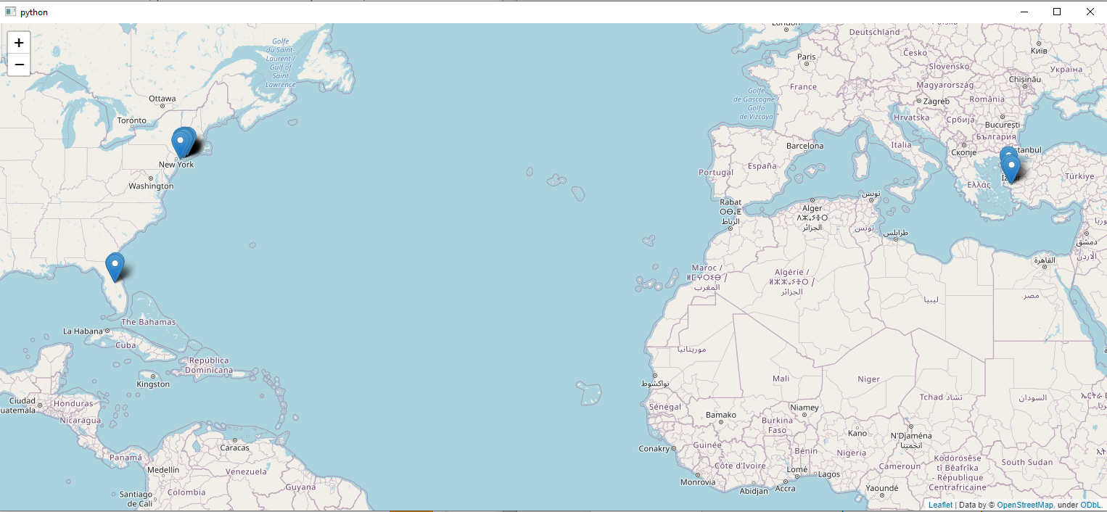
Locations on The Map

Slide 9
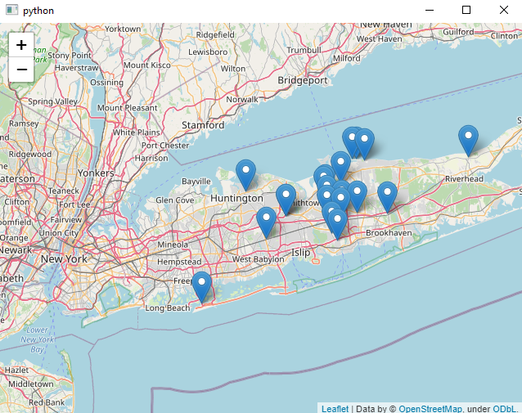
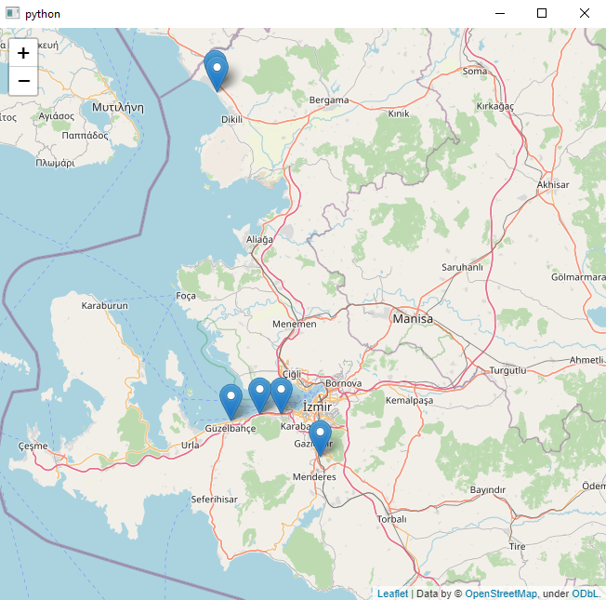
Locations on The Map

Slide 10
FUTURE WORK
Auto tagging keywords for every image file
Listing the images by clicking the location icon
Searching images by keywords

Slide 11
Thank you…

